Slide 1
ONLINE SHOPPING SYSTEM

Slide 2
agenda
Creating a simple online shopping website using Java with Hibernate.

Slide 3
Entities
1.Admin
2.User
3.Products
4.Order
5.Payment

Slide 4
packages
1.OnlineShopping.entity
2.OnlineShopping.dao
3.OnlineShopping.Services
4.com.ramya.OnlineSopping which contains main method .

Slide 5
About ALL ENTITIES
Admin : In this project admin is existing one . admin manages products.
User : User can register and login and he can view the products to buy.
Product : In this admin can add , update , delete the products.

Slide 6
Order : user can add products to order . User can buy many products according to that mount is calculated.
Payment : In payment we add payment type and we can pay amount.

Slide 7
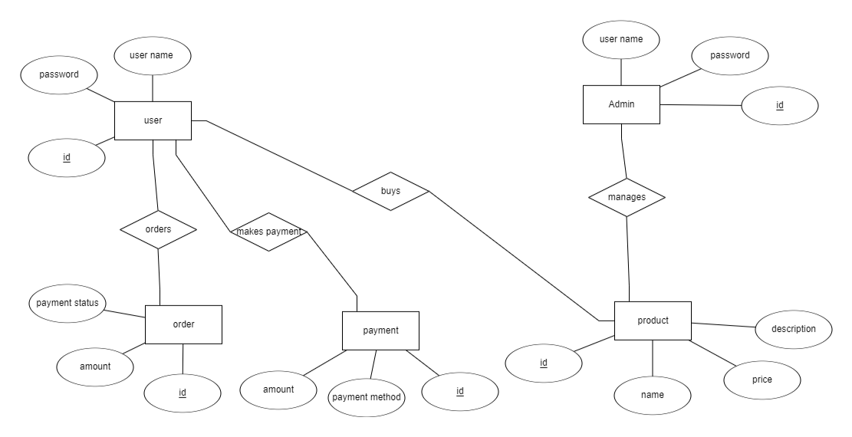
Er diagram

Slide 8
SUBMITTED BY
Batch : ANP-C7970
NAMES : Ramya Dudikatla
Zuberia Shaik
ID’s : AF0400942
AF0400800

